Slide 1
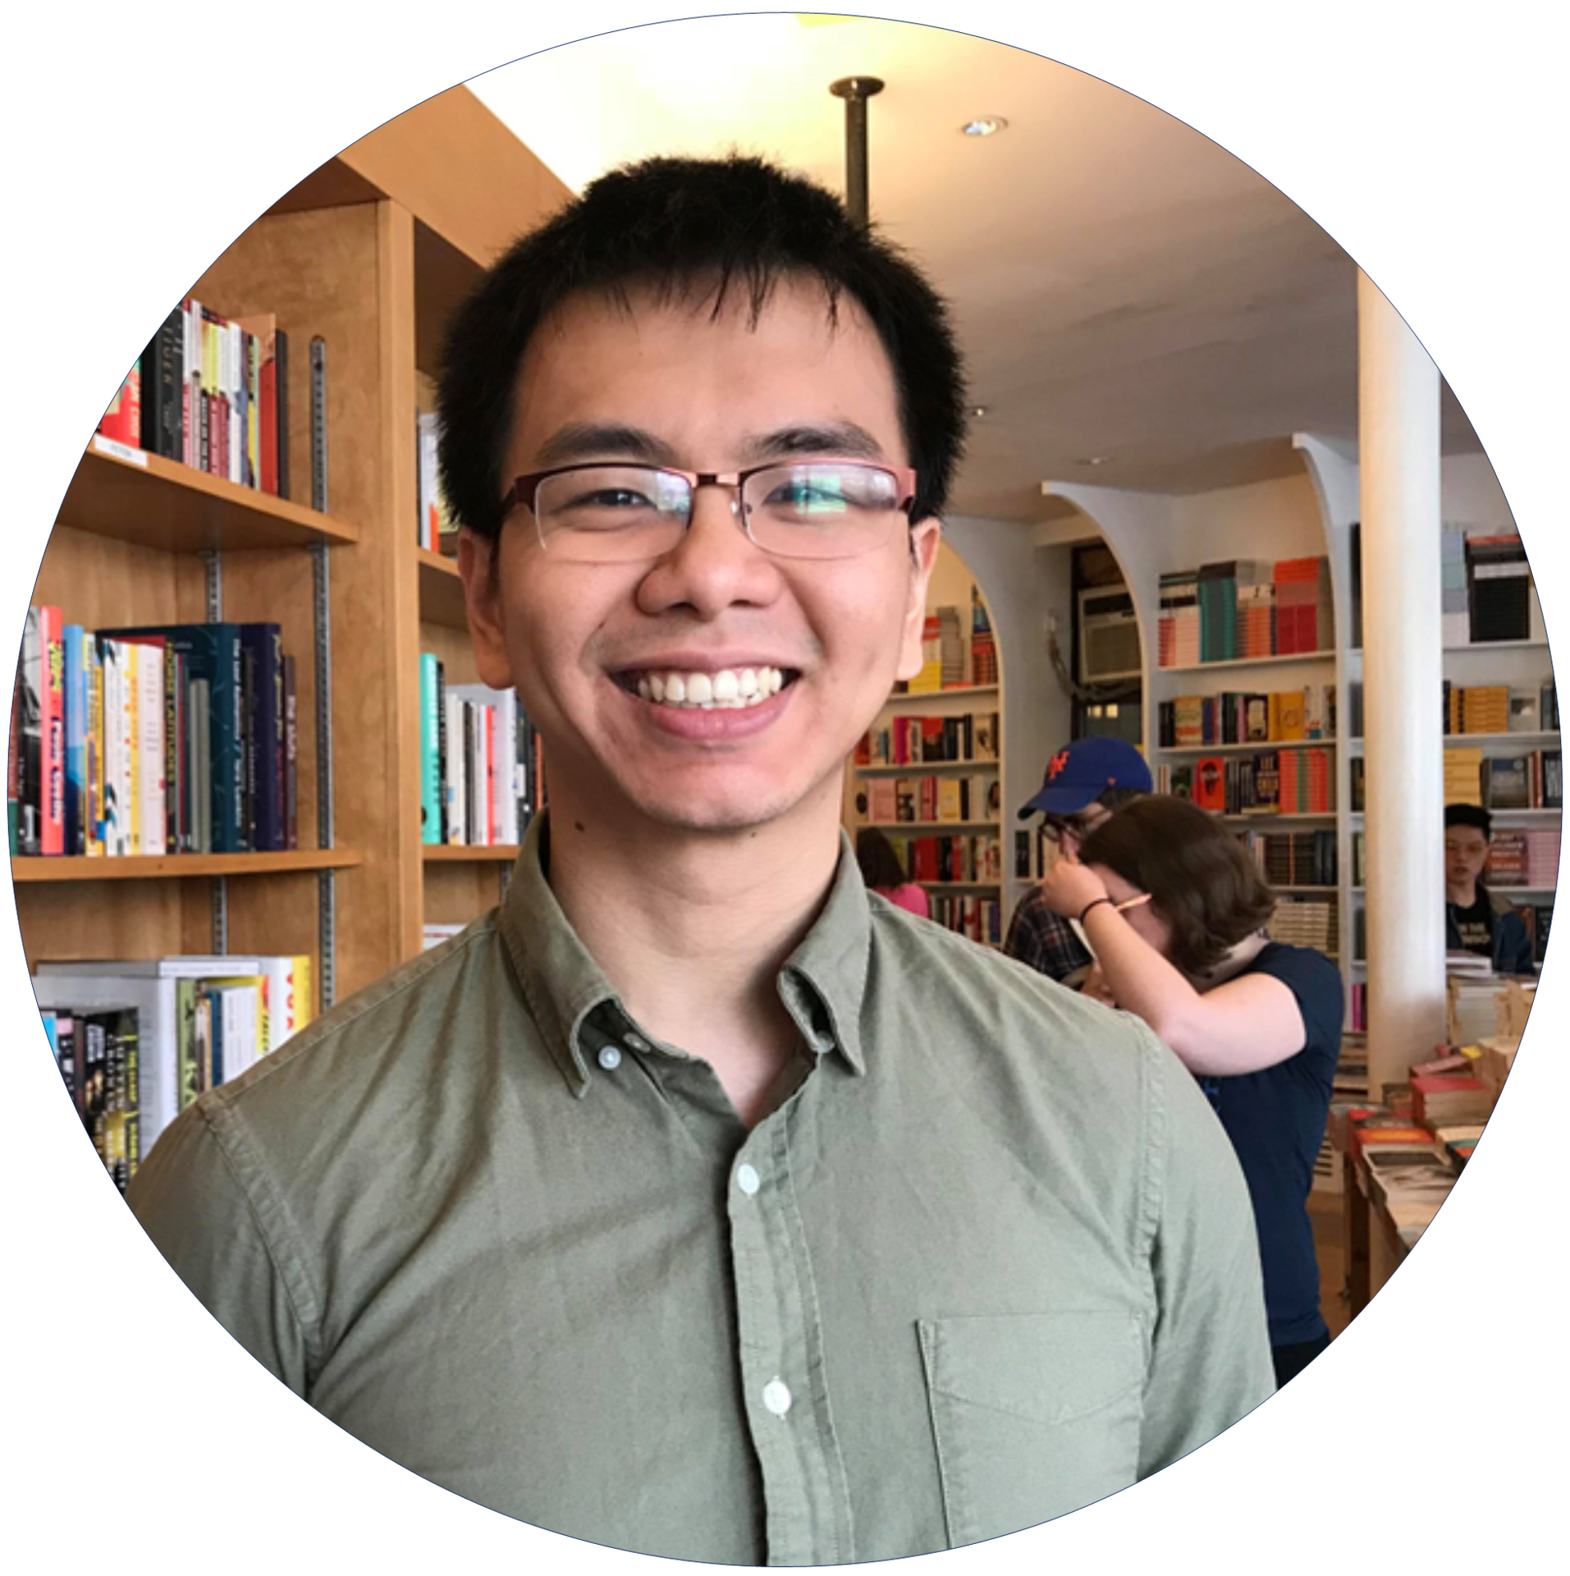
I’m Hieu and I have a passion for Web Development.
As a self taught web developer, it is a weakness but also one of my greatest strength.
My Work
Thanks for checking out!

Slide 2
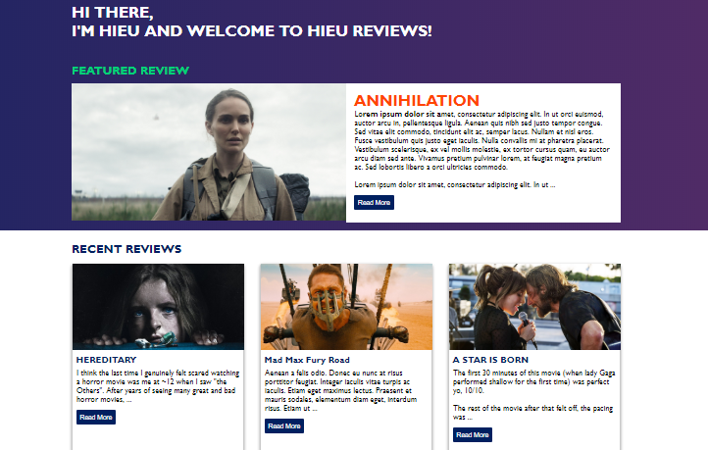
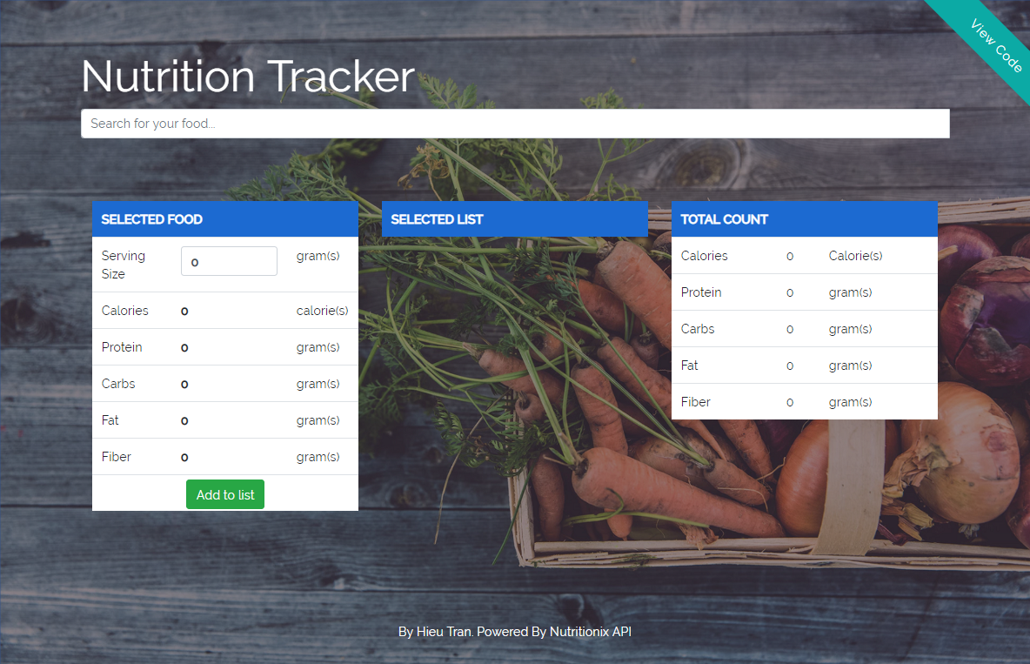




I’m Hieu and I have a passion for Web Development.
As a self taught web developer, it is a weakness but also one of my greatest strength. As a self taught web developer, it is a weakness but also one of my greatest strength.
As a self taught web developer, it is a weakness but also one of my greatest strength.
My Work
As a self taught web developer, it is a weakness but also one of my greatest strength. As a self taught web developer, it is a weakness but also one of my greatest strength.
As a self taught web developer, it is a weakness but also one of my greatest strength.
Visit the site
As a self taught web developer, it is a weakness but also one of my greatest strength. As a self taught web developer, it is a weakness but also one of my greatest strength.
As a self taught web developer, it is a weakness but also one of my greatest strength.
Visit the site
Connect with me

Slide 3

I’m Hieu and I have a passion for Web Development.
As a self taught web developer, it is a weakness but also one of my greatest strength. As a self taught web developer, it is a weakness but also one of my greatest strength.
As a self taught web developer, it is a weakness but also one of my greatest strength.
My Personal Projects
Visit the site
Visit the site
Coming Soon!
As a self taught web developer, it is a weakness but also one of my greatest strength. As a self taught web developer, it is a weakness but also one of my greatest strength.
As a self taught web developer, it is a weakness but also one of my greatest strength. As a self taught web developer, it is a weakness but also one of my greatest strength.
Connect with me:

Slide 4




I’m Hieu and I have a passion for Web Development.
As a self taught web developer, it is a weakness but also one of my greatest strength. As a self taught web developer, it is a weakness but also one of my greatest strength.
As a self taught web developer, it is a weakness but also one of my greatest strength.
My Personal Projects
Visit the site
Visit the site
Coming Soon!
As a self taught web developer, it is a weakness but also one of my greatest strength. As a self taught web developer, it is a weakness but also one of my greatest strength.
As a self taught web developer, it is a weakness but also one of my greatest strength. As a self taught web developer, it is a weakness but also one of my greatest strength.
As a self taught web developer, it is a weakness but also one of my greatest strength. As a self taught web developer, it is a weakness but also one of my greatest strength.
My Skills
Connect with me:

Slide 5
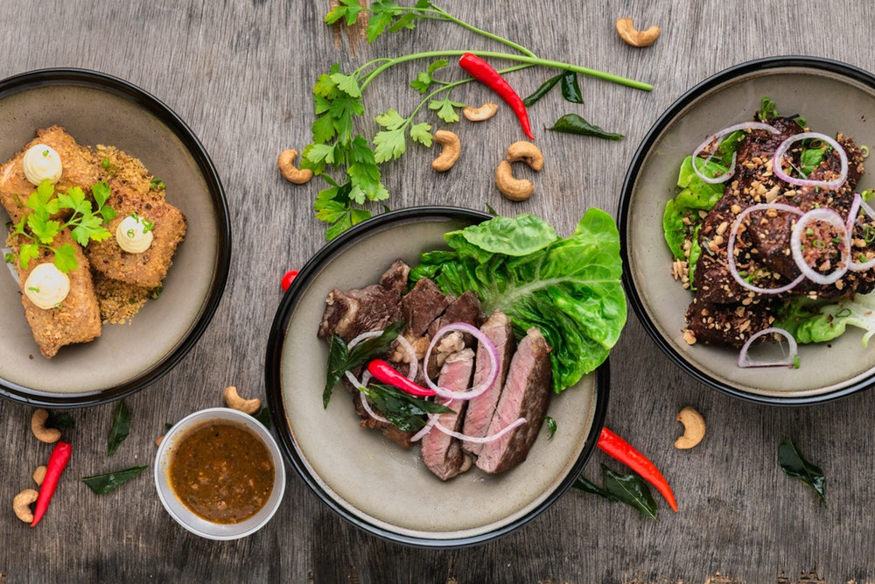
I’m Hieu and I have a passion for Web Development.
As a self taught web developer, it is a weakness but also one of my greatest strength. As a self taught web developer, it is a weakness but also one of my greatest strength.
As a self taught web developer, it is a weakness but also one of my greatest strength.
Nutrition
Tracker
My Personal Projects
Visit the site
Visit the site
Coming Soon!
As a self taught web developer, it is a weakness but also one of my greatest strength. As a self taught web developer, it is a weakness but also one of my greatest strength.
As a self taught web developer, it is a weakness but also one of my greatest strength. As a self taught web developer, it is a weakness but also one of my greatest strength.
As a self taught web developer, it is a weakness but also one of my greatest strength. As a self taught web developer, it is a weakness but also one of my greatest strength.
My Skills
Connect with me:

Slide 6


I’m Hieu and I have a passion for Web Development.
As a self taught web developer, it is a weakness but also one of my greatest strength. As a self taught web developer, it is a weakness but also one of my greatest strength.
As a self taught web developer, it is a weakness but also one of my greatest strength.
My Personal Projects
Nutrition
Tracker
Nutrition
Tracker
Coming Soon!
As a self taught web developer, it is a weakness but also one of my greatest strength. As a self taught web developer, it is a weakness but also one of my greatest strength.
As a self taught web developer, it is a weakness but also one of my greatest strength. As a self taught web developer, it is a weakness but also one of my greatest strength.
As a self taught web developer, it is a weakness but also one of my greatest strength. As a self taught web developer, it is a weakness but also one of my greatest strength.
My Skills
Connect with me:

Slide 7
Hello! I'm Hieu and it's nice to virtually meet you :)
As a self taught web developer, it is a weakness but also one of my greatest strength. As a self taught web developer, it is a weakness but also one of my greatest strength.
My Personal Projects
Visit the site
As a self taught web developer, it is a weakness but also one of my greatest strength. As a self taught web developer, it is a weakness but also one of my greatest strength.
Visit the site
As a self taught web developer, it is a weakness but also one of my greatest strength. As a self taught web developer, it is a weakness but also one of my greatest strength.
Coming Soon!
As a self taught web developer, it is a weakness but also one of my greatest strength. As a self taught web developer, it is a weakness but also one of my greatest strength.
My Skills
Connect with me:

Slide 8
I’m Hieu and I have a passion for Web Development.
As a self taught web developer, it is a weakness but also one of my greatest strength. As a self taught web developer, it is a weakness but also one of my greatest strength.
As a self taught web developer, it is a weakness but also one of my greatest strength.
My Work
Visit the site
Visit the site
Connect with me

Slide 9
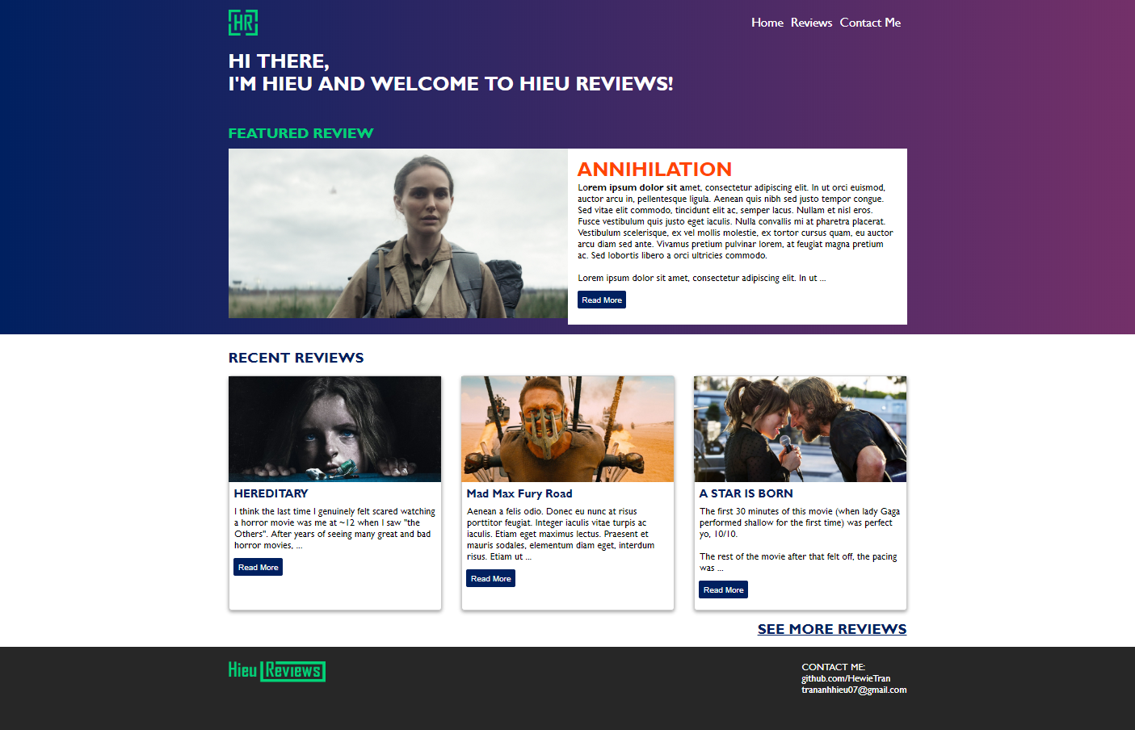
Visit the site
Visit the site
Coming Soon!

Slide 10
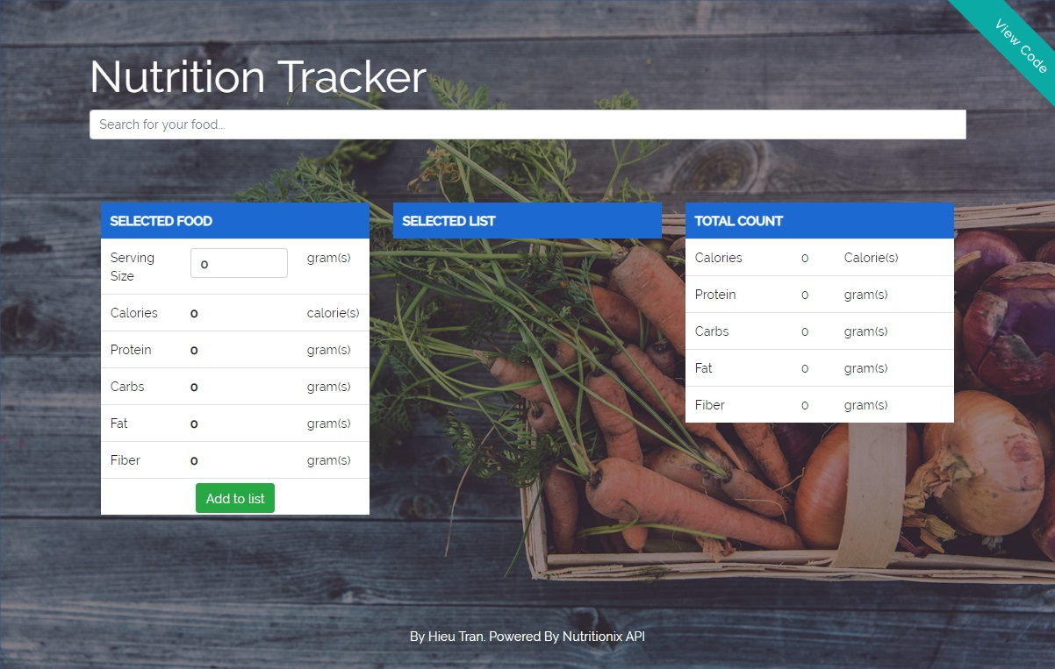
Visit the site

Slide 11
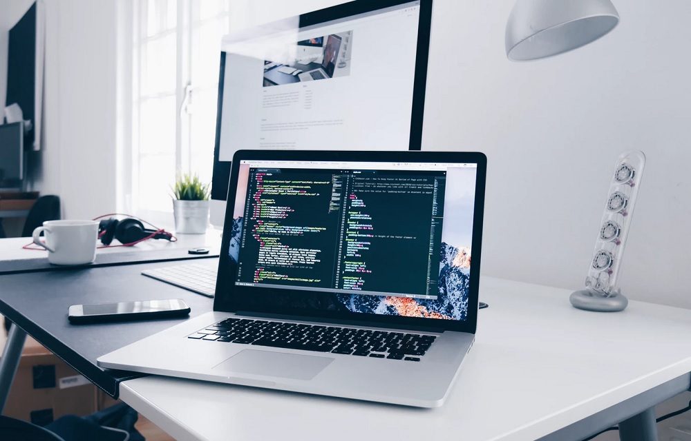

Slide 12
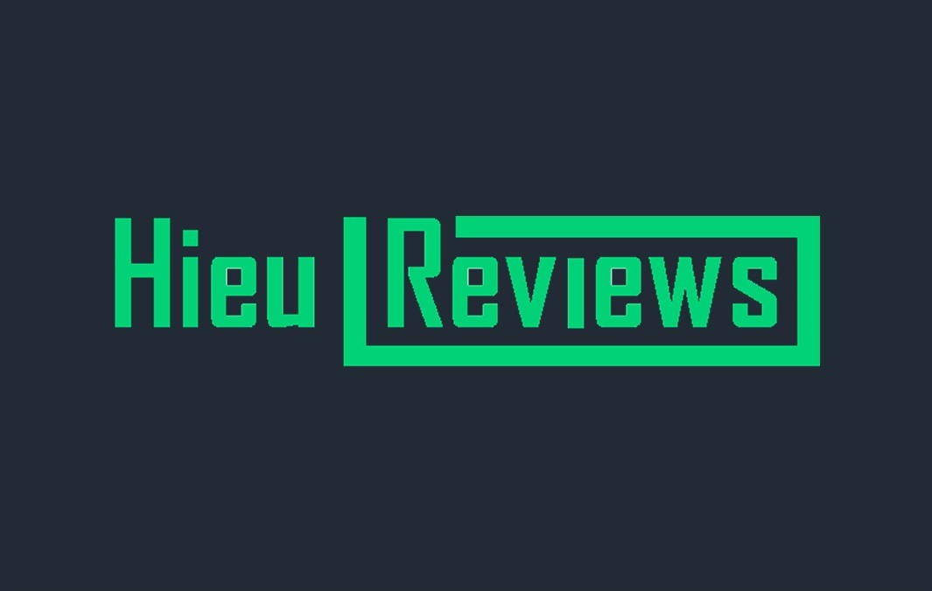
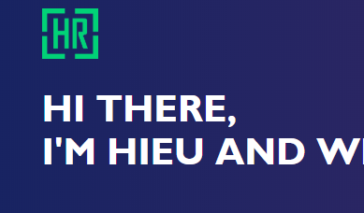
Nutrition
Tracker

Slide 13
H.

